Slide 1
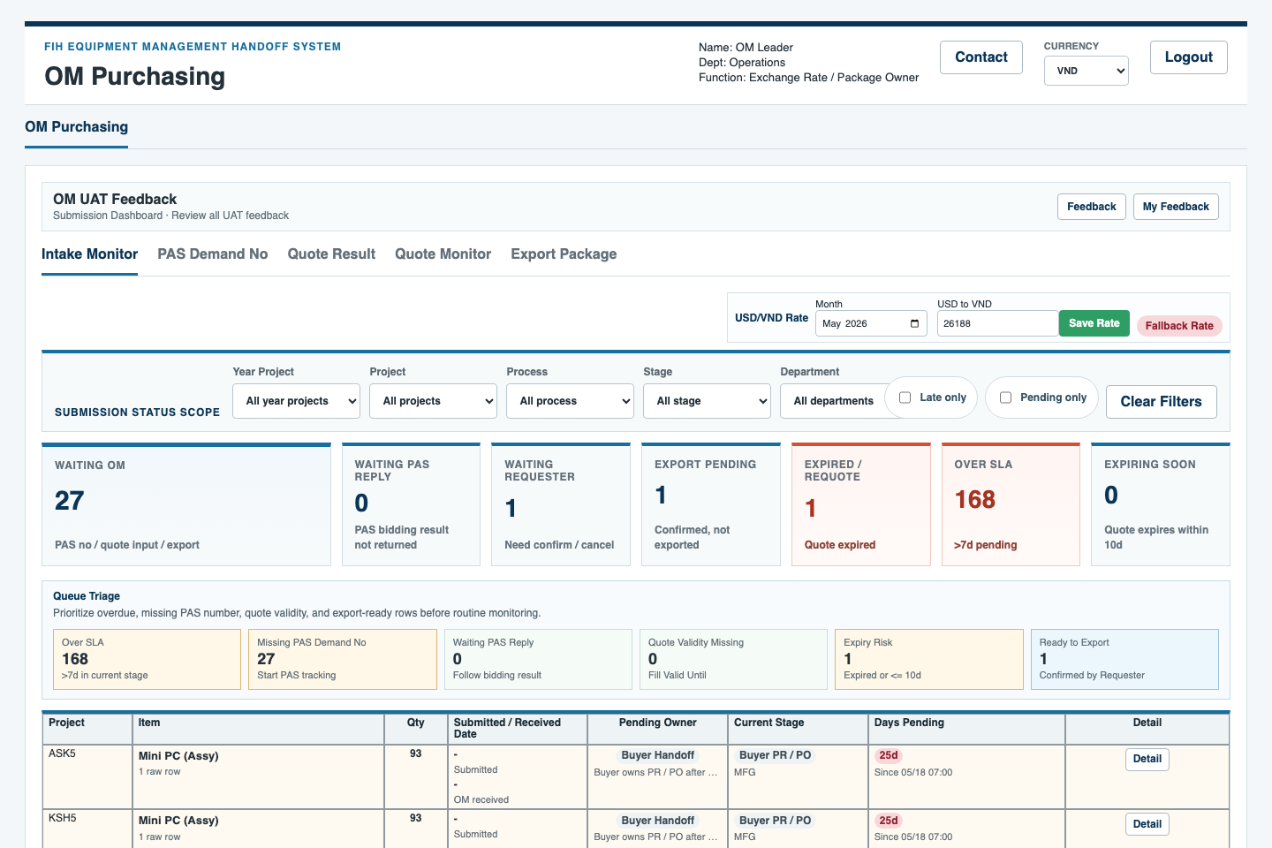
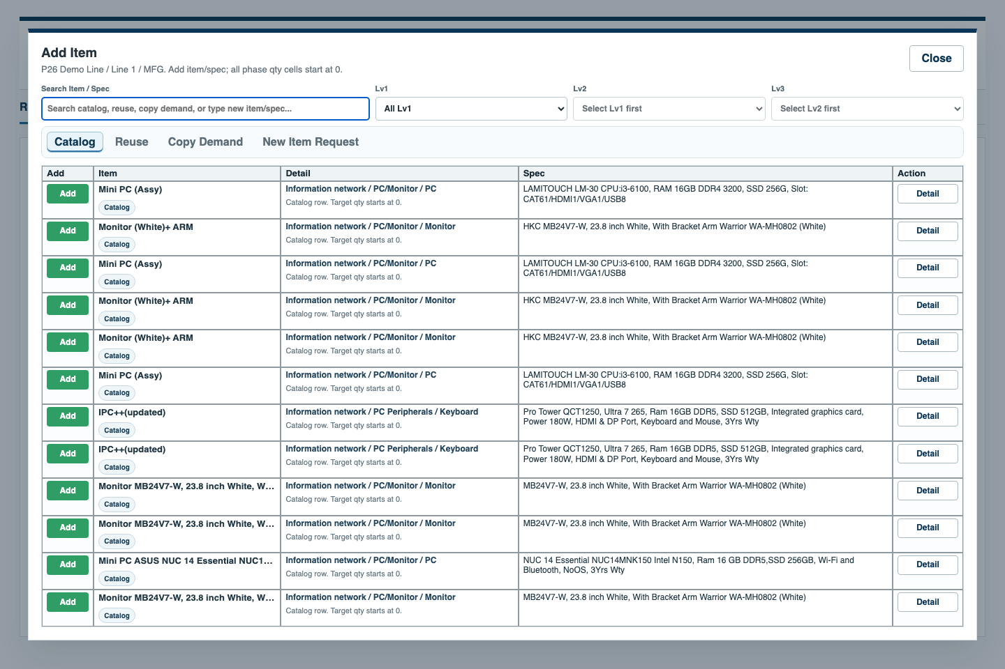
OM Leader QA Demo Flow
How to simulate Requester input, verify OM Leader controls, switch to OM Purchasing for data entry, and send practical suggestions.
Audience
Output
• QA owner: OM Leader
• Use role switching to simulate Requester, OM Leader, and OM Purchasing
• OM Leader verifies flow and permissions; OM Purchasing enters OM data
• Screenshots are from the local prototype demo
• This deck is a simple operation guide
• Do not treat screenshot-only review as full accessibility or backend validation
FIH Equipment Management Handoff System | QA rehearsal | 1

Slide 2
OM LEADER QA DEMO
QA rehearsal path
1
Choose role
2
Requester input
3
Submit / observe
4
OM Leader review
Start from the login role selector.
Add item and enter need date / quantity context.
Check whether the next action is clear.
Open OM dashboard and validate scope.
5
OM Leader controls
6
OM Purchasing input
7
Feedback review
8
Decision follow-up
Assign rows and monitor risks; do not enter quote data.
Enter PAS demand, quote result, and export package data.
Record issues or suggestions with owner/status.
Confirm whether a rule or UI change is needed.
Boundary to remember
• The QA owner may simulate Requester input, but OM Leader is not the business approver.
• OM Leader can see all OM rows and manage assignment, exchange rate utility, risk review, and feedback triage.
• PAS demand numbers, quote result fields, and export package data belong to OM Purchasing.
FIH Equipment Management Handoff System | QA rehearsal | 2

Slide 3
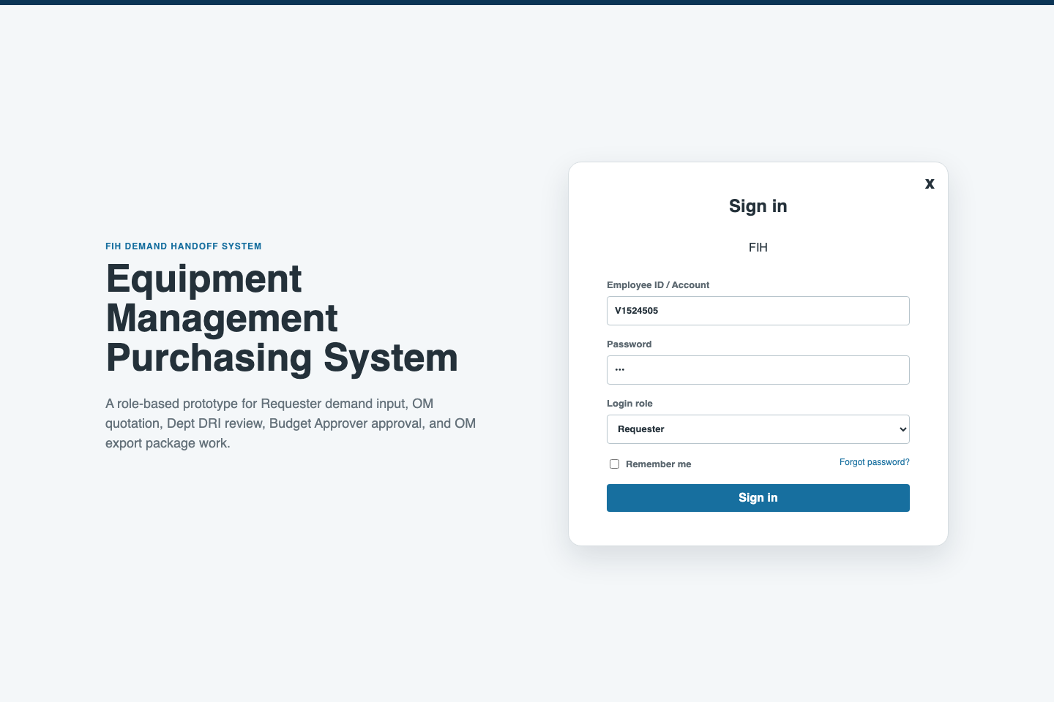
OM LEADER QA DEMO
Step 1: choose the role for each test pass
QA owner: OM Leader
Start from role selection
What to do
• First choose Requester for input simulation.
• Then switch to OM Leader for controls.
• Switch to OM Purchasing for data-entry steps.
What to check
• Role names are understandable.
• It is clear that one QA person can test multiple roles.
Suggestion prompt
• Ask: is role switching clear enough for UAT?
FIH Equipment Management Handoff System | QA rehearsal | 3

Slide 4
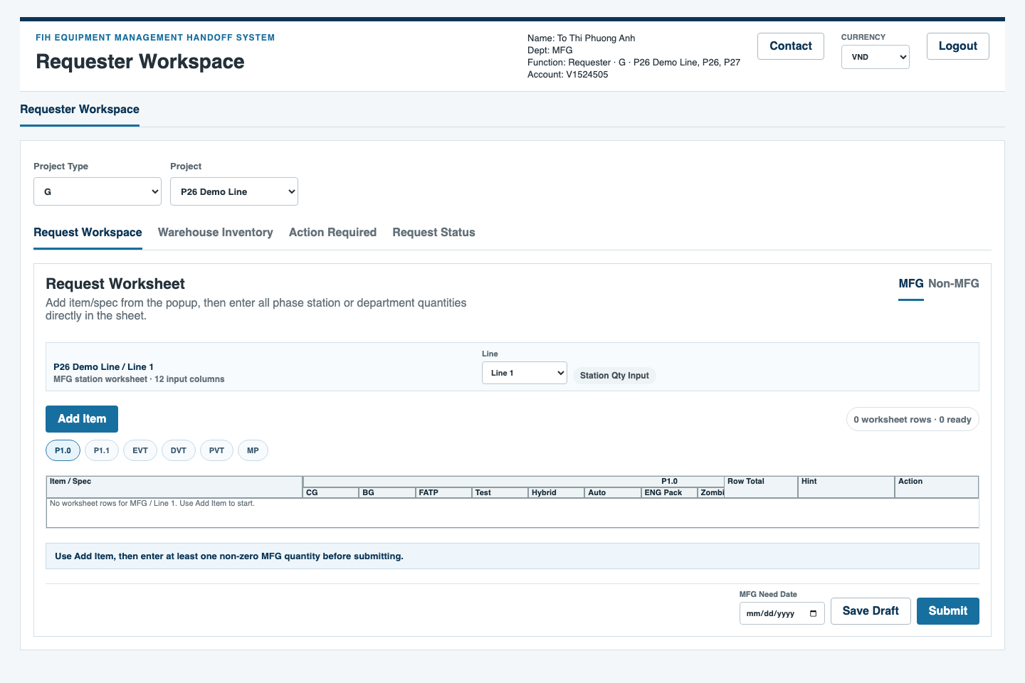
OM LEADER QA DEMO
Step 2: simulate Requester input
Simulated role: Requester
Open Request Worksheet
What to do
• Select project and line context.
• Review MFG / Non-MFG mode before entering data.
What to check
• The input table explains where quantity belongs.
• Requester fields do not expose internal OM/vendor data.
Suggestion prompt
• Ask: which field labels confuse requesters?
FIH Equipment Management Handoff System | QA rehearsal | 4

Slide 5
OM LEADER QA DEMO
Step 3: add an item/spec
Simulated role: Requester
Use Add Item
What to do
• Search or pick the item.
• Use Detail if the spec needs confirmation.
What to check
• The list is searchable and readable.
• The selected item/spec is specific enough for downstream OM work.
Suggestion prompt
• Ask: what item naming or spec info is missing?
FIH Equipment Management Handoff System | QA rehearsal | 5

Slide 6

OM LEADER QA DEMO
Step 4: prepare the requester submission
Simulated role: Requester
Need date and submit area
What to do
• Enter need date.
• Check the submit note before sending.
What to check
• The submit button is easy to find.
• Missing quantity or date guidance is visible before submit.
Suggestion prompt
• Ask: what validation message would help before submission?
FIH Equipment Management Handoff System | QA rehearsal | 6

Slide 7
OM LEADER QA DEMO
Step 5: review OM Leader dashboard
Actual role: OM Leader
Open Submission Dashboard
What to do
• Logout/login as OM Leader.
• Review summary, risk cards, pending owner, and filters.
What to check
• Mai can see all OM rows.
• Dashboard separates tracking from business approval.
Suggestion prompt
• Ask: what risk or owner filter should be added?
FIH Equipment Management Handoff System | QA rehearsal | 7

Slide 8
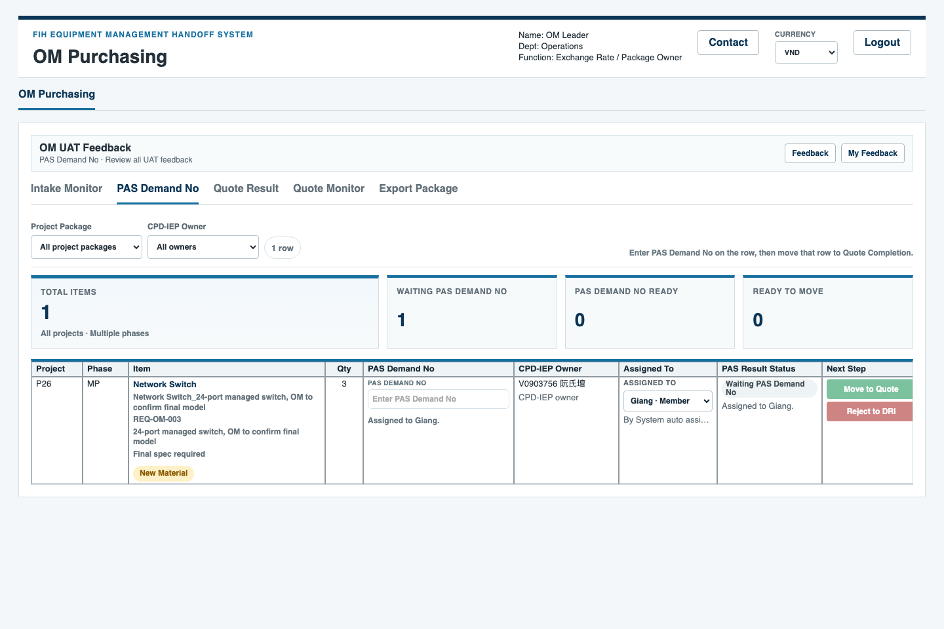
OM LEADER QA DEMO
Step 6: assign OM rows
Actual role: OM Leader
Assign / reassign owner
What to do
• Open PAS Demand No tab.
• Use Assigned To to choose Giang or Linh.
What to check
• Assignment control is visible only for OM Leader.
• CPD-IEP Owner is not confused with OM assignee.
Suggestion prompt
• Ask: should auto-assignment explanation be clearer?
FIH Equipment Management Handoff System | QA rehearsal | 8

Slide 9
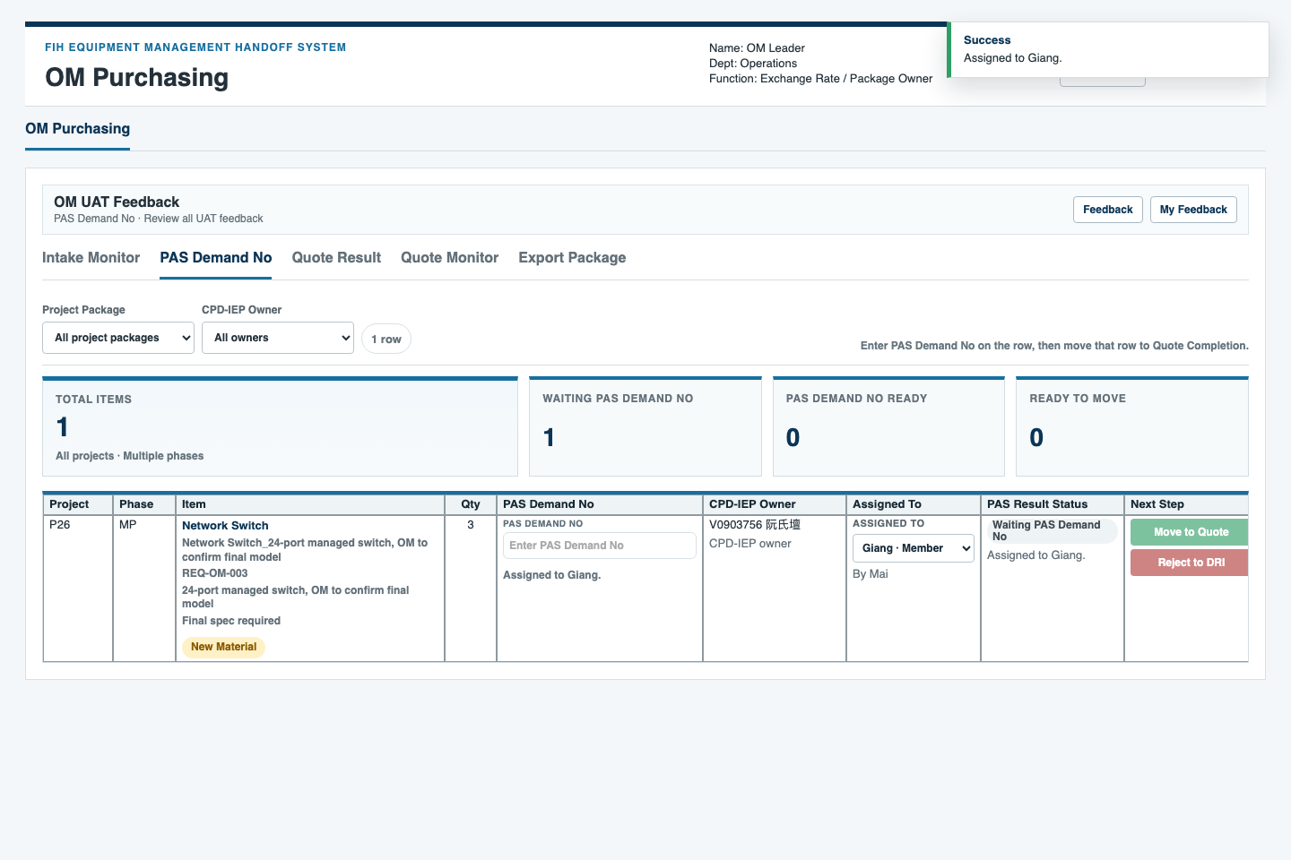
OM LEADER QA DEMO
Step 7: confirm assignment result
Actual role: OM Leader
Check assigned state
What to do
• Confirm the row now shows the intended OM Purchasing owner.
• Stop here for OM Leader; do not enter PAS or quote row data.
What to check
• Assigned owner persists during the local session.
• Next action still points to the correct OM Purchasing work.
Suggestion prompt
• Ask: should assignment changes need a note or reason?
FIH Equipment Management Handoff System | QA rehearsal | 9

Slide 10
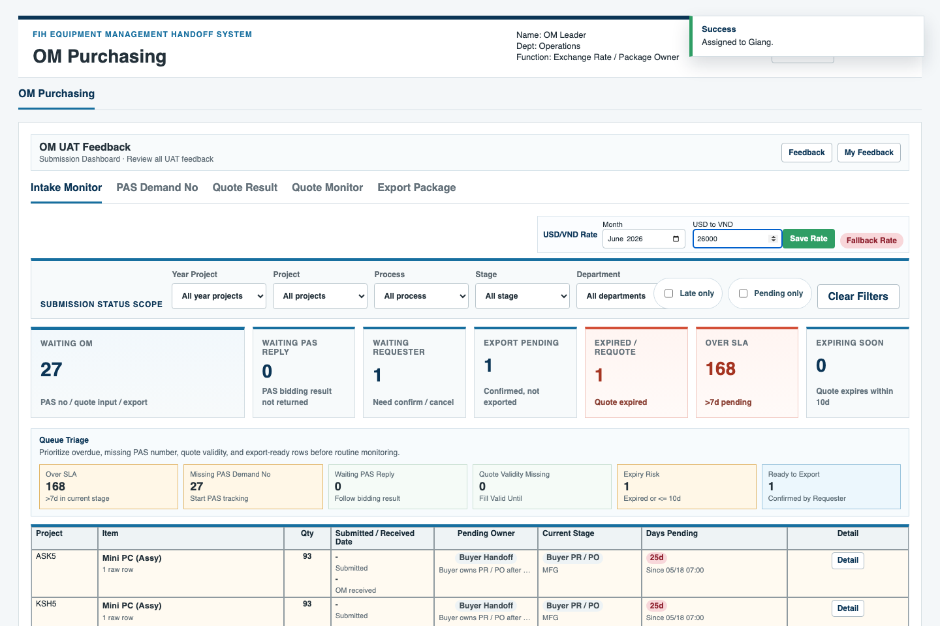
OM LEADER QA DEMO
Step 8: maintain exchange rate
Actual role: OM Leader
Update USD/VND rate
What to do
• Set month and rate.
• Save rate for current calculation context.
What to check
• Only Mai/Admin should edit exchange rate utility.
• This is separate from PAS / quote / export row data entry.
Suggestion prompt
• Ask: should rate history or last updated by be more visible?
FIH Equipment Management Handoff System | QA rehearsal | 10

Slide 11
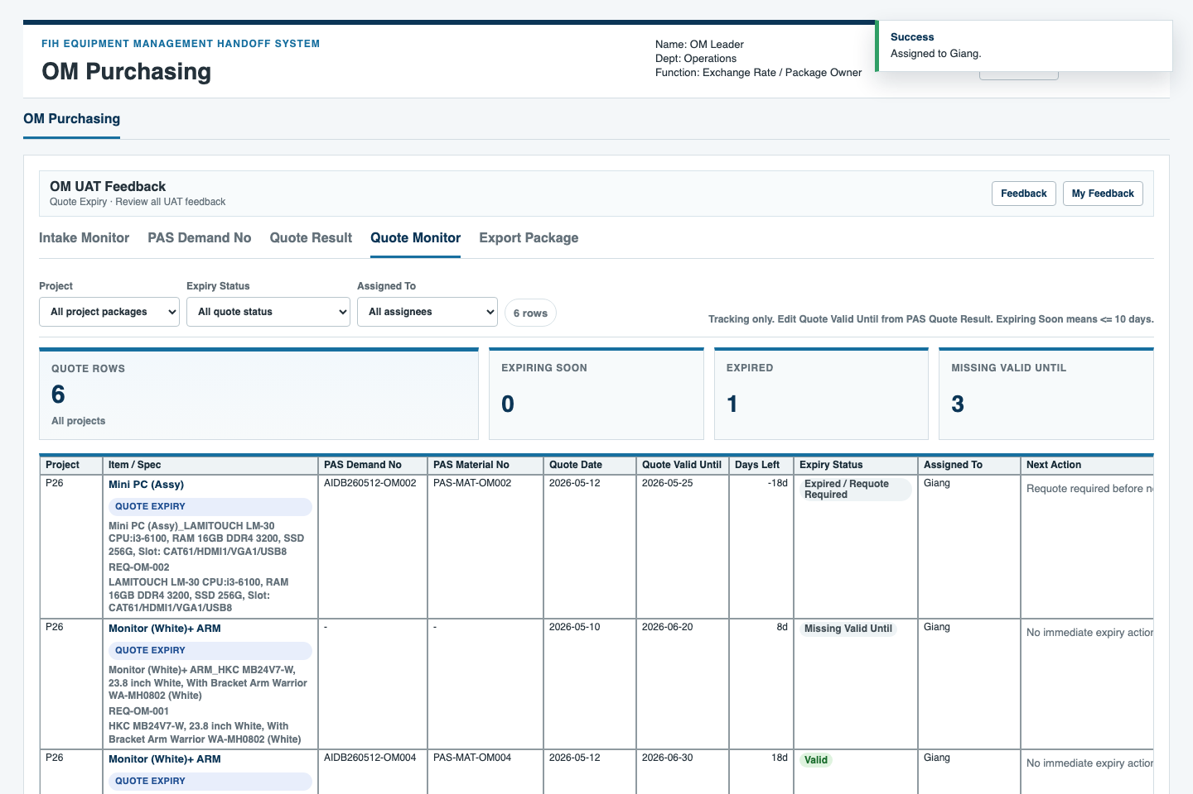
OM LEADER QA DEMO
Step 9: monitor quote expiry
Actual role: OM Leader
Open Quote Expiry
What to do
• Filter by project, status, or assignee.
• Review expiring / missing quote validity.
What to check
• Expired and missing valid-until rows are easy to distinguish.
• Next action is concrete enough for follow-up.
Suggestion prompt
• Ask: what reminder threshold should OM use?
FIH Equipment Management Handoff System | QA rehearsal | 11

Slide 12
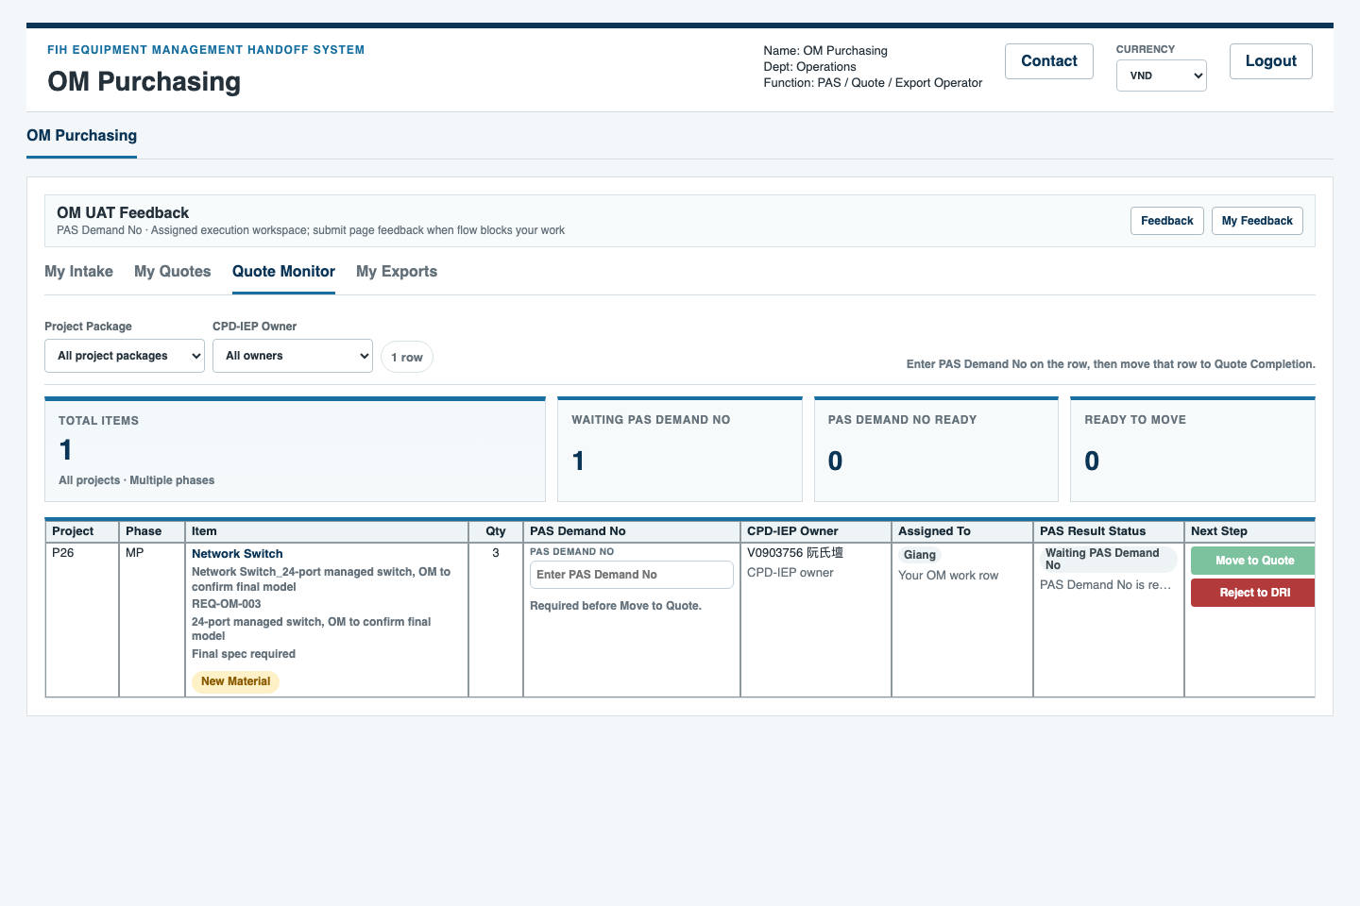
OM LEADER QA DEMO
Step 10: switch to OM Purchasing for data entry
Actual data-entry role: OM Purchasing
Login as OM Purchasing
What to do
• Logout from OM Leader.
• Login as OM Purchasing, e.g. Giang.
• Confirm the page shows assigned work scope.
What to check
• OM Purchasing sees assigned rows, not OM Leader assignment controls.
• Tabs use My Intake / My Quotes / My Exports language.
Suggestion prompt
• Ask: is the handoff from Leader to Purchasing clear?
FIH Equipment Management Handoff System | QA rehearsal | 12

Slide 13

OM LEADER QA DEMO
Step 11: OM Purchasing enters PAS demand data
Actual data-entry role: OM Purchasing
My Intake / PAS Demand No
What to do
• Open PAS Demand No / My Intake.
• Enter or update PAS demand number when the row is ready.
What to check
• Only assigned OM Purchasing work is actionable.
• The row still shows who assigned it and the current next step.
Suggestion prompt
• Ask: which PAS demand fields need clearer validation?
FIH Equipment Management Handoff System | QA rehearsal | 13

Slide 14
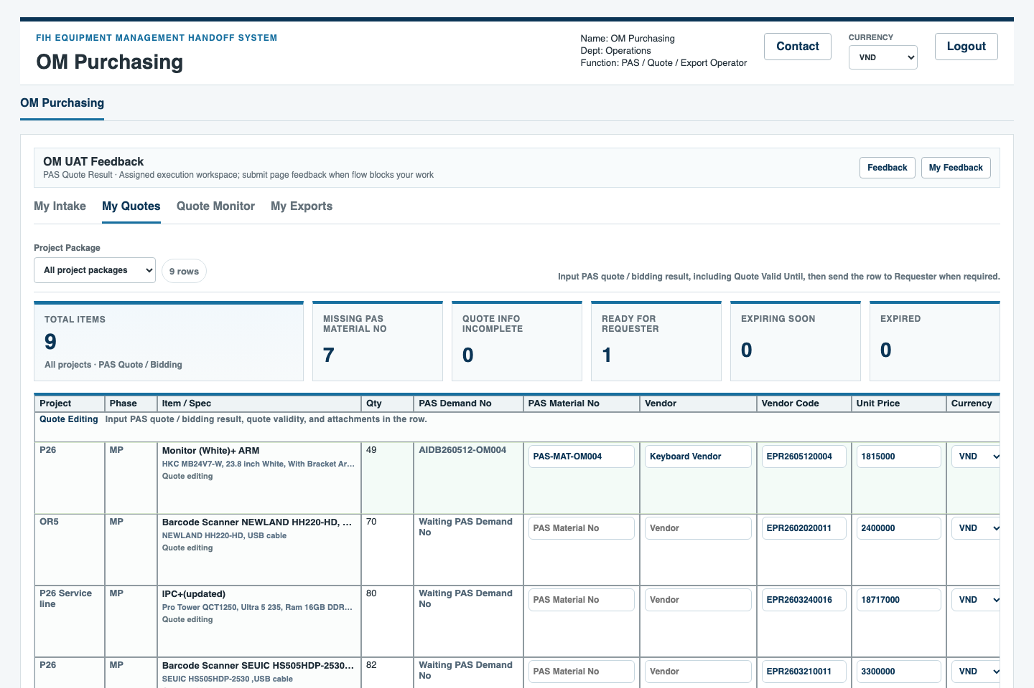
OM LEADER QA DEMO
Step 12: OM Purchasing enters quote result data
Actual data-entry role: OM Purchasing
My Quotes / PAS Quote Result
What to do
• Open PAS Quote Result / My Quotes.
• Fill quote-related data such as material, vendor, price, currency, date, and files.
What to check
• Quote input fields are editable for OM Purchasing.
• Missing fields and completion status are easy to understand.
Suggestion prompt
• Ask: which quote fields should be required before export?
FIH Equipment Management Handoff System | QA rehearsal | 14

Slide 15
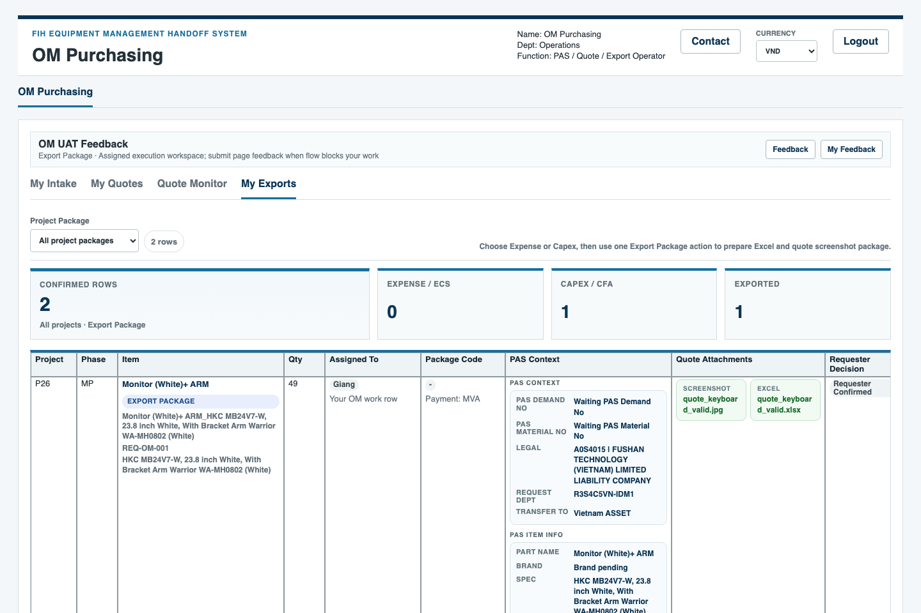
OM LEADER QA DEMO
Step 13: OM Purchasing prepares export package
Actual data-entry role: OM Purchasing
My Exports / Export Package
What to do
• Open Export Package / My Exports.
• Review rows ready for package/export and buyer handoff.
What to check
• Export readiness is visible.
• The package owner and buyer handoff context are clear.
Suggestion prompt
• Ask: what package checklist is missing before buyer handoff?
FIH Equipment Management Handoff System | QA rehearsal | 15

Slide 16
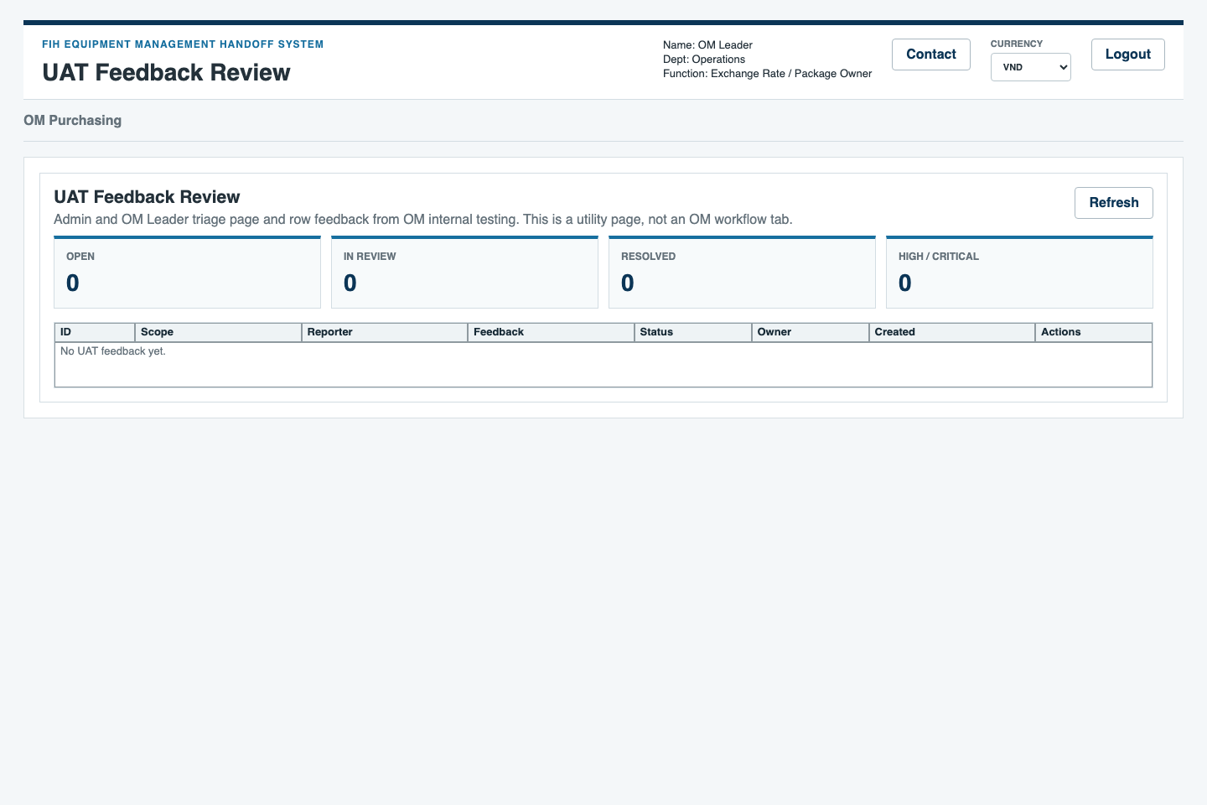
OM LEADER QA DEMO
Step 14: review and send suggestions
Actual role: OM Leader
Use UAT Feedback Review
What to do
• Return to OM Leader if feedback triage is needed.
• Record issue, owner, severity, and suggestion.
What to check
• Feedback status and owner are visible.
• Empty state is understandable when no feedback exists.
Suggestion prompt
• Ask: should suggestions be grouped by page, role, or severity?
FIH Equipment Management Handoff System | QA rehearsal | 16

Slide 17
OM LEADER QA DEMO
Suggestion template for OM Leader
Use this format
Priority guide
• Role simulated: Requester / OM Leader / OM Purchasing
• Step and screen: e.g., Step 12 - PAS Quote Result
• What happened: one sentence
• Expected behavior: one sentence
• Business impact: unclear owner, missing data, wrong calculation, or usability issue
• Suggested change: keep it concrete
• High: blocks requester input, OM assignment, OM Purchasing data entry, export, or approval handoff
• Medium: confusing but workaround exists
• Low: wording, spacing, or convenience improvement
Evidence to attach
• Screenshot filename or screen name
• Role used during the test
• Project / item / row if relevant
• Whether the issue is repeatable
FIH Equipment Management Handoff System | QA rehearsal | 17

